Slide 1

WATER POTABILITY PREDICTION
PROJECT MENTOR : Mr.RITESH MAURY
START DATE : 09May2022
END DATE : 09June2022
TEAM MEMBERS:
ABIRAMI RANGARAJ
LAKHAN PATIDAR
KRISHNA NAIR
SHEETAL KASHYAP

Slide 2

DOMAIN KNOWLEDGE
Water is the most significant resource of life, contaminated water and poor sanitation leads to diseases.
Thus to determine water is potable to use or not which facilitates the practice of hygiene.

Slide 3
PROBLEM STATEMENT
Without clean water people cannot obtain a safe source of hydration.
Thus the objective is to analyse and make predictions regarding projected water quality by its parameters by using machine learning models.
Hence it is identified as Classification Based model.

Slide 4
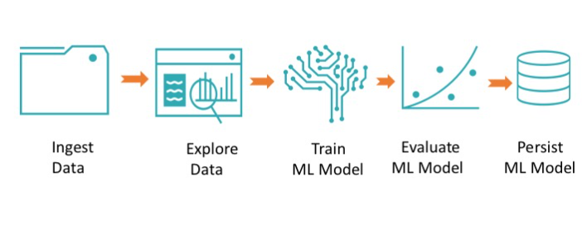
PROJECT FLOW

Slide 5
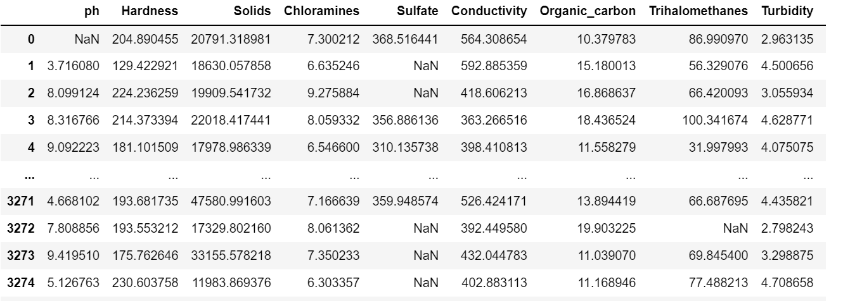
DATA COLLECTION
DATA SET DETAILS: 3276 Samples,10 Features

Slide 6
DATA PREPROCESSING
EDA Involves:
Check for duplicate values
Missing value Handling
Outlier Detection
Imbalanced data
Correlation

Slide 7
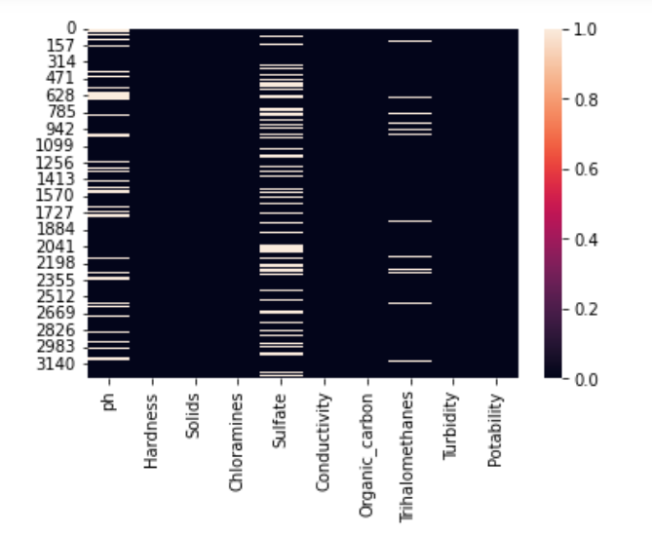
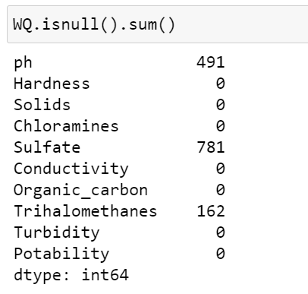
EXPLORATORY DATA ANALYSIS
Missing value Handling:

Slide 8
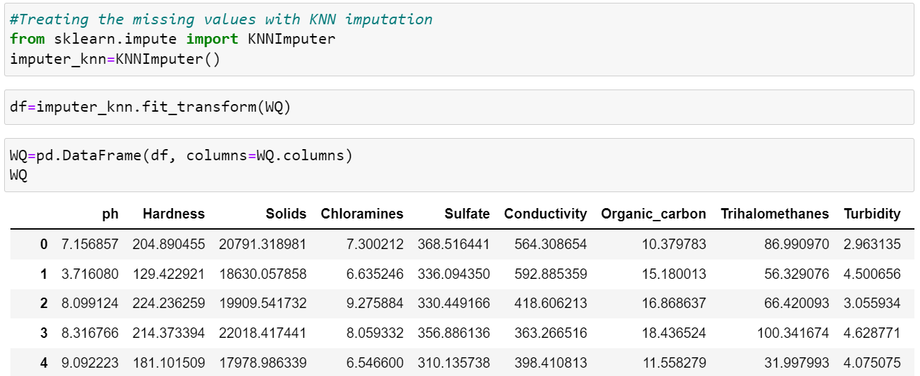
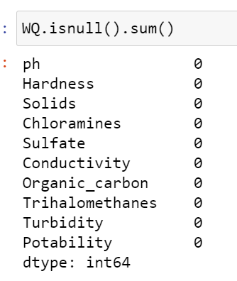
EXPLORATORY DATA ANALYSIS
Using KNN Imputer
After treating null values:

Slide 9
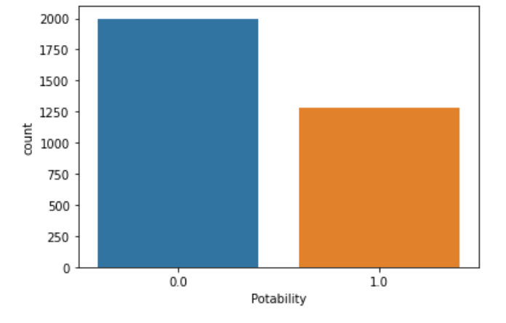
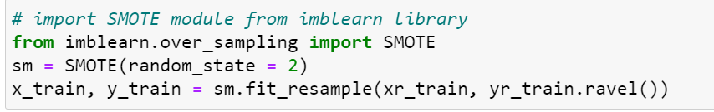
EXPLORATORY DATA ANALYSIS
Data imbalance is treated by SMOTE method

Slide 10
MODEL BUILDING
As my model is a Classifier based model, so I have used following classifier for model building.
Decision Tree Classifier
Random Forest
Logistic Regression
Kneighbors Classifier
XGBoost

Slide 11
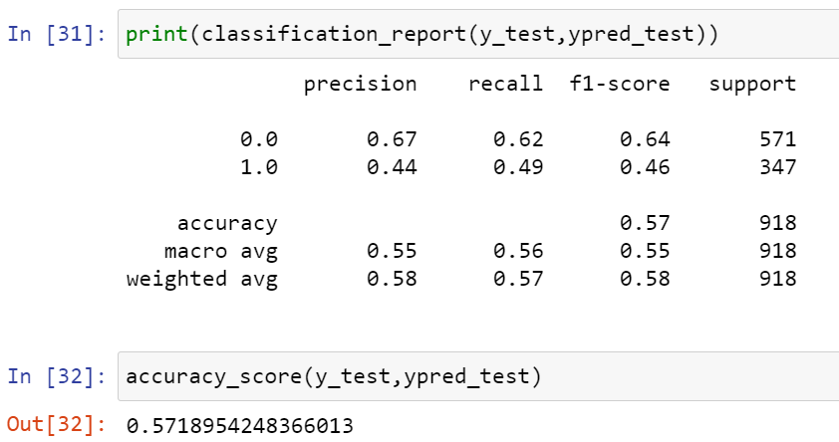
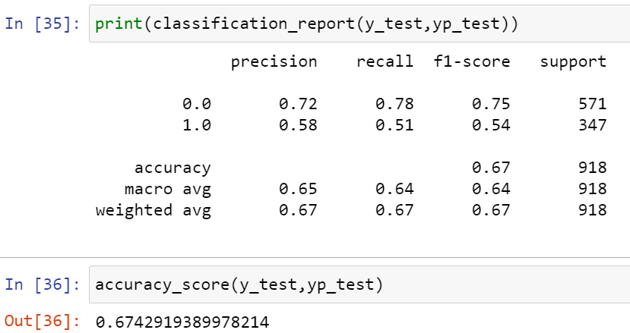
MODEL EVALUATION
Model performance for Decision Tree: 57.1%
Model performance for Random Forest: 67.4%

Slide 12
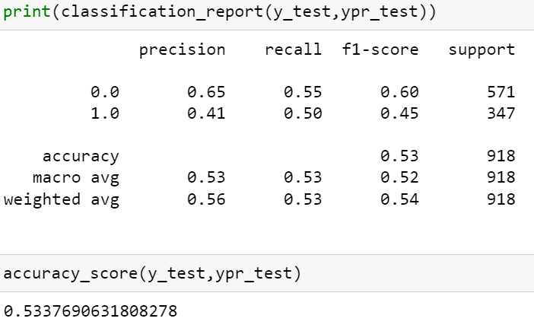
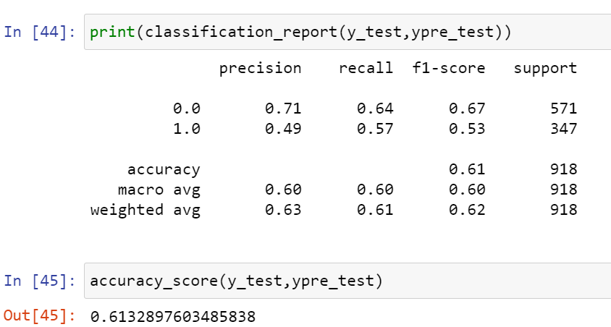
MODEL EVALUATION
Model performance for Logistic Regression: 53.3%
Model performance for KNN: 67.4%

Slide 13
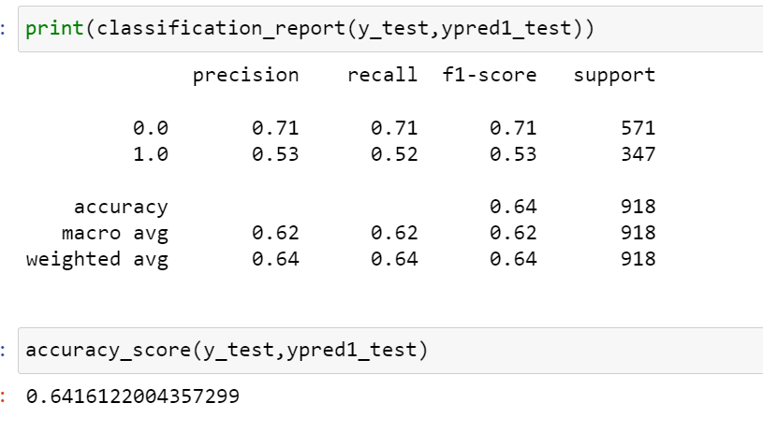
MODEL EVALUATION
Model performance for XGBOOST : 64.1%

Slide 14
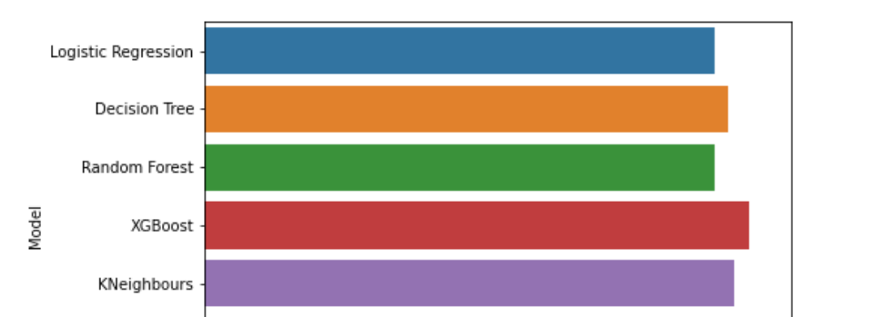
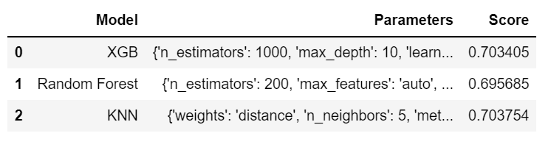
MODEL PREDICTION
Thus by Hyper Parameter tuning XGBOOST classifier has improvised accuracy score of 70.3%.

Slide 15
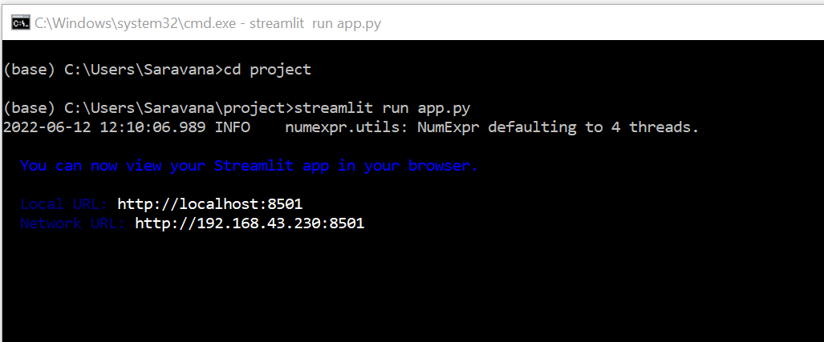
MODEL DEPLOYMENT
Thus Streamlit function is finally use for deploying the model.

Slide 16
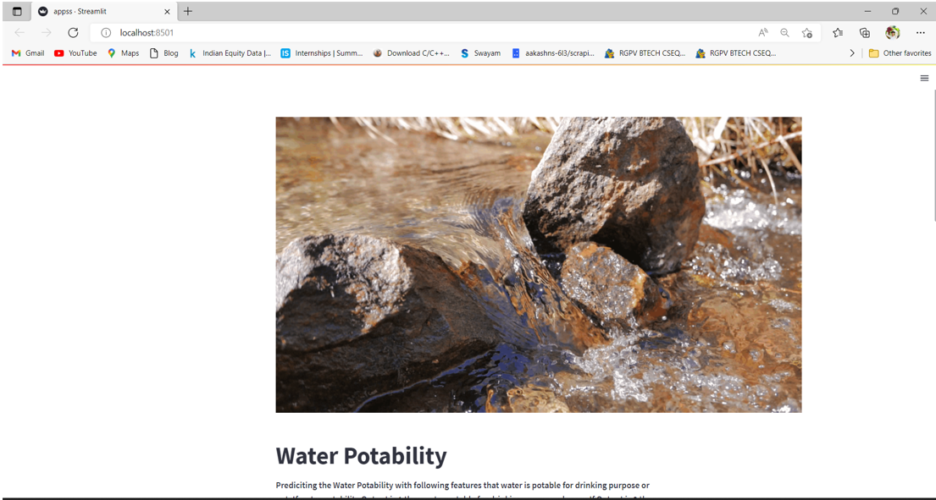
MODEL DEPLOYMENT

Slide 17
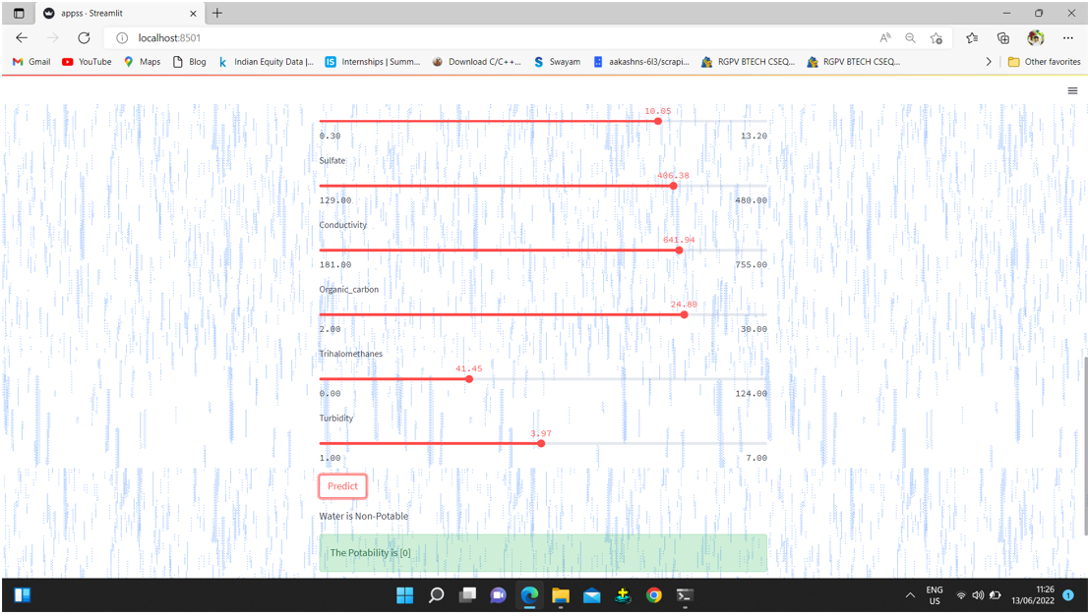
MODEL DEPLOYMENT

Slide 18
THANK YOU

